Slide 1

Shareholder Presentation
ESTABLISHED MARKET LEADER IN PIPE MANUFACTURING
36th Annual General Meeting
Date: 16th July, 2021
Time: 12:30 pm

Slide 2
Building on fundamental strengths to drive profitable growth
Structurally tuned to succeed with diversified presence across products, customers and geographies with agility to respond to market dynamics
STEADY PERFORMANCE MOMENTUM
Key Nos. for FY21
Continue moving towards value added segments
Quality of execution linked to restoration of momentum
Emphasis on debt discipline underlining balance sheet strength
Robust portfolio offerings across segments contributing to sustained performance
Diversified Product Offerings
Revenues
Strong Group Backing
Rs. 8,910 Cr
COMPETITIVE EDGE
EBITDA
Experienced Management Personnel
Manufacturing Excellence
Rs. 1,257 Cr
PAT
Rs. 329 Cr
Marquee Clientele
Extensive Geographical Reach
DIFFERENTIATED OFFERINGS & DERISKED MODEL
Leadership position across strategic business segments
Integrated operating model for all pipe applications
Forayed into value added offerings
Note: Standalone numbers considered for Revenues, EBITDA & PAT

Slide 3

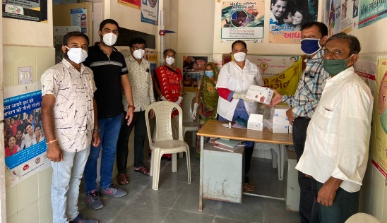
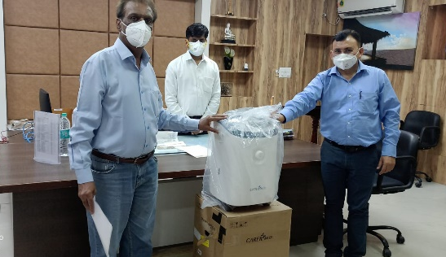
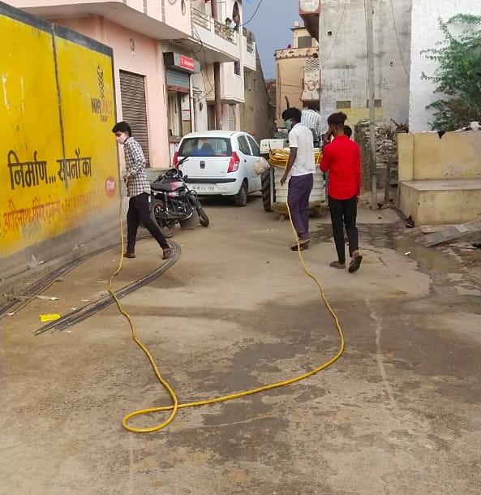
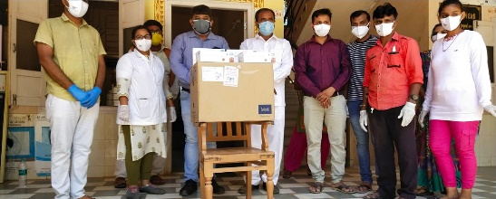
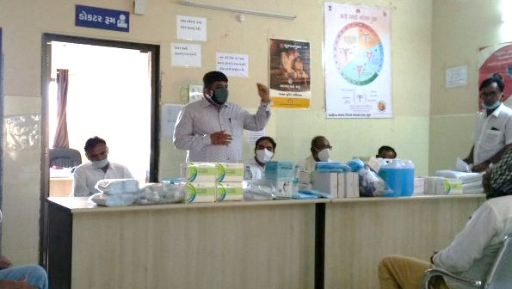
Swift response to CoVID-19: CSR initiative
Jindal Saw extended every possible assistance to the society:
Contributed portable oxygen concentrators to hospitals and other medical facilities
Converted existing nitrogen plant to an oxygen plant (capacity equivalent to 450 oxygen cylinders per day) for online supply of oxygen to patients through pipelines
Donated Sodium Hypochlorite, spray pumps, thermal guns and supplied firewood to the Hindu cremation centers
Deployed tankers of liquid oxygen to refill Oxygen cylinders for government hospitals
Set up vaccination centers
Provided financial aid to hospitals & state governments for COVID relief
3

Slide 4
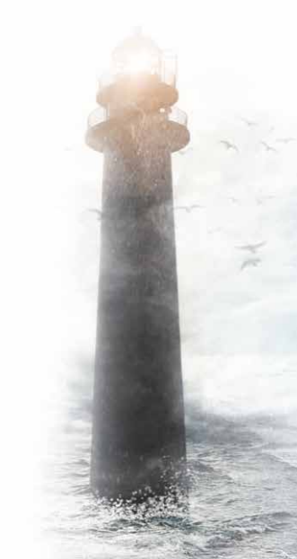
Embedded on core principles
THE SPIRIT OF TEAM JINDAL SAW (JSAW)
Team Jindal SAW has used the pandemic-enforced lockdown to innovate and build on its fundamental strength, to stay on course for a stellar performance and good business. It as also developed ideas and initiatives to help JSAW become more resilient. These are:
Atmanirbhar JSAW (आत्मनिर्भर)
Manufacturing of ancillary things to strengthen the value chain
Svachaalit JSAW (स्वचालित)
Focus on automation and robotics to improve quality and reduce dependence on human labour force
Nutan JSAW (नूतन)
Repositioning of the CS/AS/SS Seamless Business based on product development and market penetration
Vayudoot JSAW (वायूदूत)
Digitisation of transport logistics for cost cutting and improved performance
Mrigya JSAW (मृगया)
Strategic mergers and acquisitions

Slide 5
FY21- Quarterly performance trends
Recovery of performance visible Q3-FY21 onwards; H1 impacted by pandemic lockdown
Cover up of H1 lag from Q3 onwards on account of execution

Slide 6
Historical Financial Trends: Jindal Saw (Standalone)
CAGR: 9.7%
Adjusting for input pricing dynamics, maintained momentum in execution
Delivered contained finance costs in FY21 despite moderation in performance
Healthy recovery momentum post nationwide lockdown

Slide 7
Historical Financial Trends: Jindal Saw (Consolidated)
CAGR: 9.7%
Enhanced contribution from overseas subsidiaries resulting in improved consolidated performance
Satisfactory order book position despite covid impact
Healthy recovery momentum post nationwide lockdown

Slide 8
Historical Financial Trends: Jindal Saw (Standalone)
Maintained scheduled repayments and working capital optimization, resulting in improved debt profile
Working capital in line with topline trend. Realised better efficiencies due to tighter receivables mgt. and credit control

Slide 9
Historical Financial Trends: Jindal Saw (Consolidated)
Continued improvement in debt profile
Focus on efficiency in working capital management

Slide 10


Forging solid partnerships to offer differentiation to customers
Jindal Saw has entered into a Strategic Alliance Agreement with Hunting Energy Services PTE Ltd. to manufacture, market and sell products which would be based on the technology available with Hunting and the manufacturing facilities available with Jindal Saw. This is based on identified potential opportunities in oil and gas sector with premium products of Hunting.
As an established market leader and a leading global manufacturer of Iron & Steel pipe products, Jindal Saw has set up manufacturing facilities across India, USA, Europe and UAE (MENA).
With emphasis on foraying into value-added products, Jindal Saw entered into the Chrome segment and won order from a leading oil & gas company
Also ventured into the stainless steel and high value-added pipes and tubes segment to cater the growing demand
Strategic Alliance with Hunting (Cutting Edge Technology Partner) for Premium Connection will further strengthen its leadership position in the market and has proven to be a key differentiator; this will benefit the Indian Oil & Gas industry in the years to come
Hunting Energy Services PTE Ltd., Singapore (Hunting) is a world leader in developing premium connection solutions to meet the increasing demand of the global oil and gas industry.

Slide 11







Business challenges on account of the pandemic
Stoppage of production during lockdowns
Maintained functional preparedness. SOPs for seamless re-starting of production
Firmness in raw material costs/steel prices
Iron ore pellets segment absorbed the impact of steel price inflation
Emphasis on efficiencies in operations mitigating cost hikes
Supply chain disruptions
Robust processes underlined quick resumption once permitted
Mid/Long term Impacts
Short term Impacts
Weakness in business momentum/execution
Renewed traction in operationalizing projects
Diversified across segments, customer segments and geographies
Agile response to market dynamics due to healthy cash flows and balance sheet strength
Repaid 1st moratorium deferred payments in full. Did not avail 2nd moratorium
Paucity of labour associated with first lockdown
On campus living philosophy protected employees and execution timelines

Slide 12
Emphasis on shareholder value creation
Focus on value for shareholders
Strong promoter holding at ~63%
Maintained dividend track record in FY21 despite pandemic-led challenges
Paid dividend to investors uninterruptedly since FY 1991-92
The Company also rewarded shareholders by giving bonus shares in FY1993-94 (ratio 1:2) and in FY1994-95 (ratio 1:1)
Market Cap missing the signal
Market Cap is ~ 56% Networth as on 31st March, 2021
Emphasis is on creating value for shareholders through relentless focus on quality of execution
Note: Market cap as on 9th July, 2021. Networth (Standalone) as on 31st March, 2021

Slide 13


Drivers of growth
Aatmanirbhar Bharat and Geo-political situation would boost the Indian manufacturing sector including key areas which are opening up like defence etc.
Sustained initiatives by GOI and State Govts to facilitate robust water & sewage infrastructure to be key focus over coming years
Dedicated thrust on investment in Oil & Gas infrastructure domestically to complement demand restoration in key global geographies
Jal Jeevan Mission –development of piped water supply infrastructure for villages and tap water connection to every rural household at an outlay of Rs. 350,000 crore
Other key ongoing initiatives include Atal Mission for Rejuvenation and Urban Transformation (AMRUT), Jal Shakti Abhiyan, Jeevan mission, Har Ghar Jal and the National Water Quality Sub Mission (for treatment of arsenic and fluoride)
GOI has proposed an investment of close to Rs. 7.5 trillion or $102.49 billion in the oil and gas sector
Budgetary includes Rs. 12,480 crore to enhance LPG production to facilitate 10 million new connections under the Pradhan Mantri Ujjwala Yojana
Planned spending of $2.86 billion in upstream oil and gas production to enhance natural gas production to 60 billion cubic metres, which is twice the current volume
Pace of economic recovery to guide restoration of oil demand
Jindal Saw will serve a wide array of applications through its foray into value-added Stainless business, including alloy steel, carbon steel, stainless steel pipes and tubes market; to be a vital growth driver going forward

Slide 14
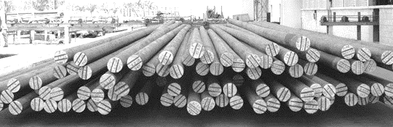
Thank You
Thank You

Slide 15

Disclaimer
Statements made during today’s discussion and those contained in this document could constitute “forward looking statements” including, without limitation, statements relating to the implementation of strategic initiatives, and other statements relating to our future business developments and economic performance. While these forward looking statements represent our judgment and future expectations concerning the development of our business, a number of risks, uncertainties and other important factors could cause actual developments and results to differ materially from our expectations.
These factors include, but are not limited to, general market, macro-economic, governmental and regulatory trends, movements in currency exchange and interest rates, competitive pressures, technological developments, changes in the financial conditions of third parties dealing with us, legislative developments, and other key factors that we have indicated could adversely affect our business and financial performance. Jindal Saw undertakes no obligation to publicly revise any forward looking statements to reflect future events or circumstances.

